Slide 1

FAFSA
Line-by-Line Overview
Amy Sloan
Higher Education Access Partner
The webinar will start promptly at 12:00

Slide 2

Welcome
What we will talk about today:
how to apply for an FSA Account (FSA ID)
how to complete the FAFSA
available resources
Pheaa.org/college-planning/student-aid-guide/

Slide 3
Questions?
I will be taking questions using the Q and A feature. Click the ? symbol to see the feature box on the right of your screen.

Slide 4



Certified Browsers
Mozilla Firefox
(Version 68+)
Google Chrome
(Version 76+)
Apple Safari
(Version 9+)
Visit studentaid.gov/help/browser-requirements for the most up-to-date information on browsers.

Slide 5
Create Your FSA ID Accounts
The student applying for aid and one parent providing information on the FAFSA need to create an FSA ID at studentaid.gov/fsa-id.
Create prior to completing the FAFSA.
Legal signature for student and parent.
Social Security Number
Username
Email Address
Password
Mobile Phone
Security Questions
Enable Two-Step Verification

Slide 6
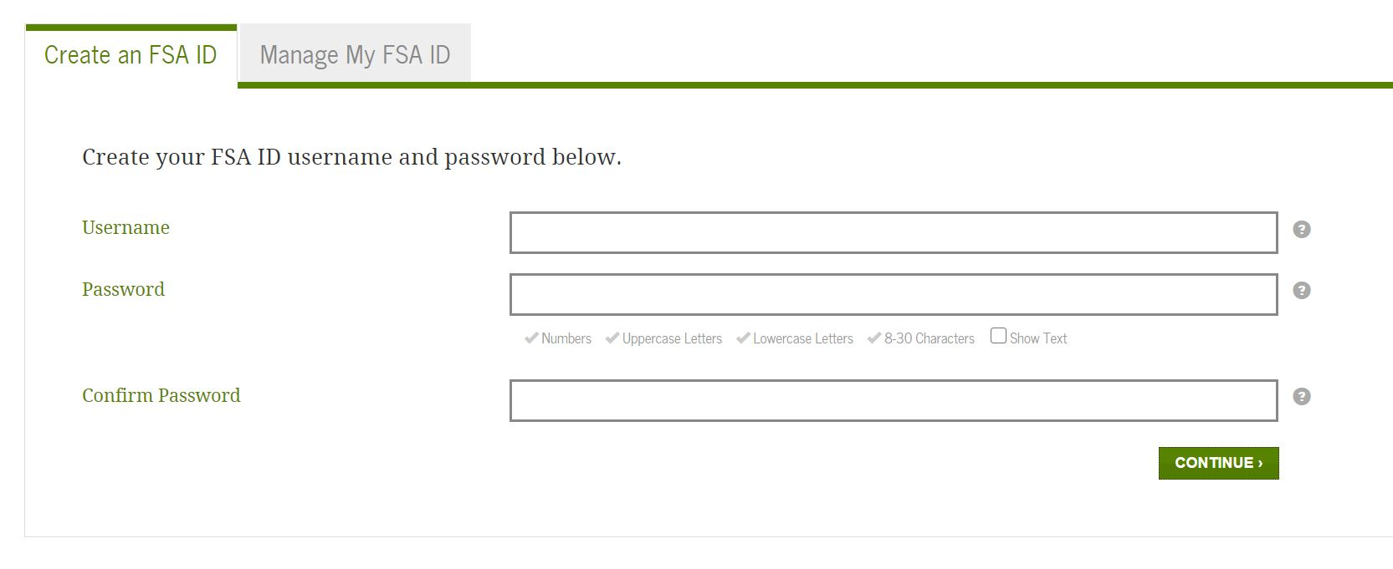
Create your FSA Account

Slide 7
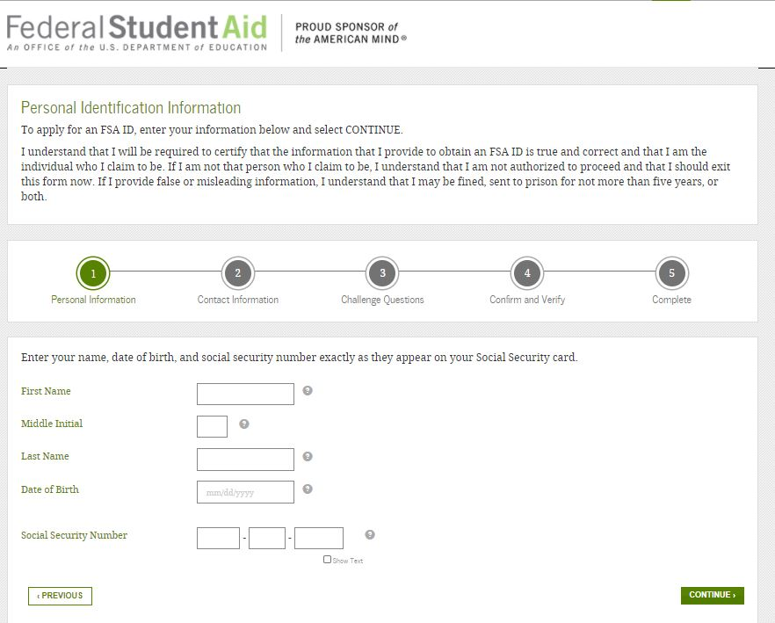
Create your FSA Account

Slide 8
Information Needed for FAFSA
Social Security Numbers
Federal Tax Returns and W-2’s (2021)
2021 Untaxed Income
Checking and Savings Account Statement Balances as of FAFSA Filing Date
Investment Records
Email Addresses
Student & Parent
Federal Student Aid
Account (FSA ID)

Slide 9
FAFSA Steps
Login – student or parent
Disclaimer – select accept
Application year
Save key
Introduction
Student Demo-graphics
School Selection
Dependency Status
Parent Demo-graphics
Financial Information
Sign and Submit
Confirmation

Slide 10
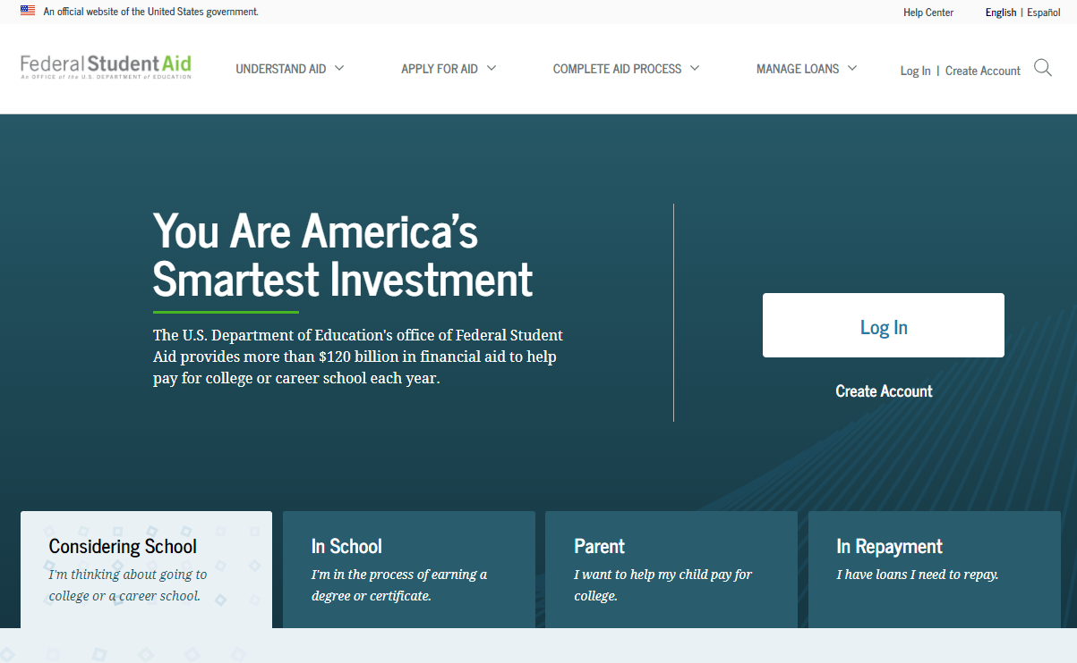
Free Application for Federal Student Aid
FAFSA - www.studentaid.gov
There is skip logic built into the FAFSA. Anytime you are asked if you want to skip questions, say yes, you will not be penalized.
Students must file a FAFSA every year they are enrolled in postsecondary education.
One-stop-shop site: www.studentaid.gov or
Notes:
The FAFSA is a federal form used to determine student eligibility for the following:
Federal programs, such as
Pell Grants, work-study, and student loans
Some state programs, such as the Pennsylvania State Grant
School programs, such as
need-based grants and
scholarships

Slide 11
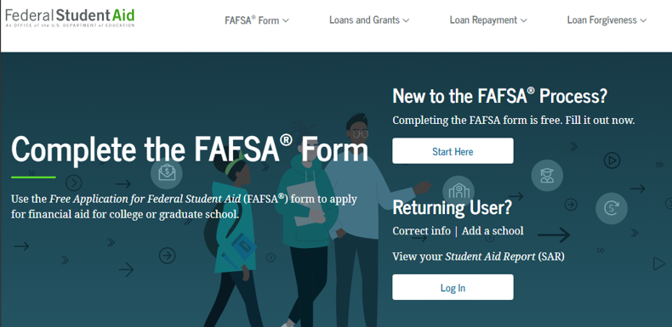
FAFSA Landing Page – www.studentaid.gov/fafsa

Slide 12
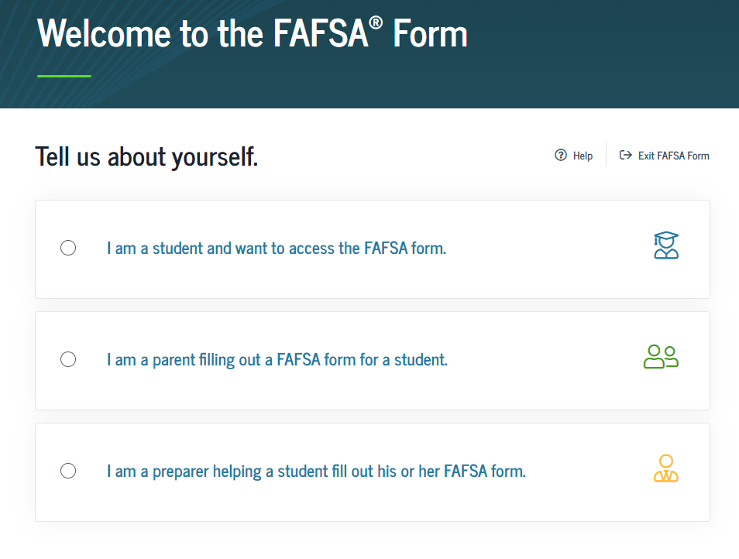
Role Selection

Slide 13
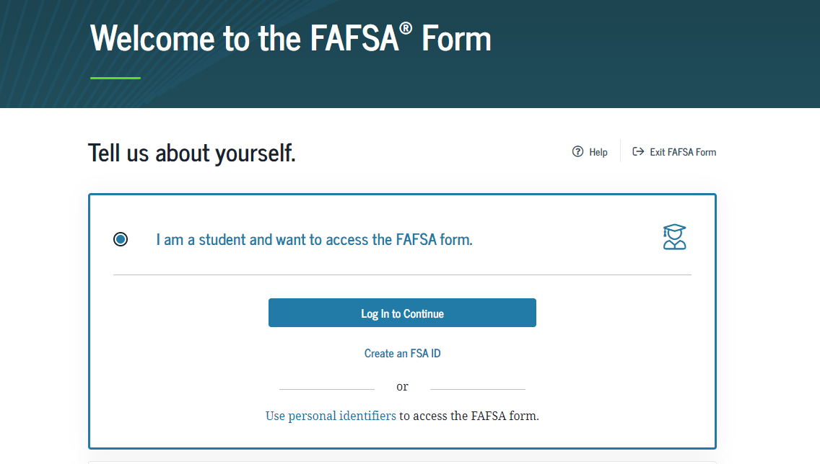
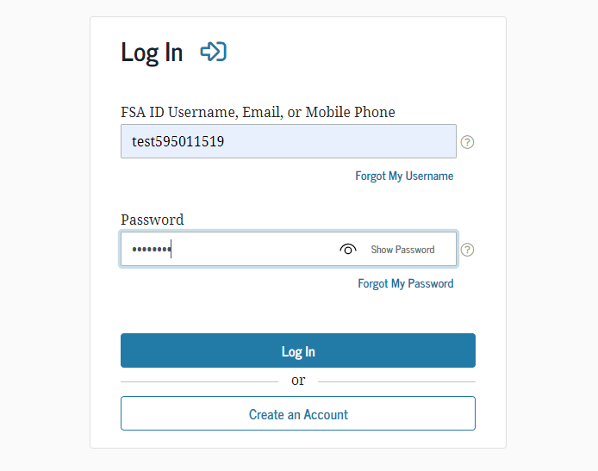
Log In

Slide 14
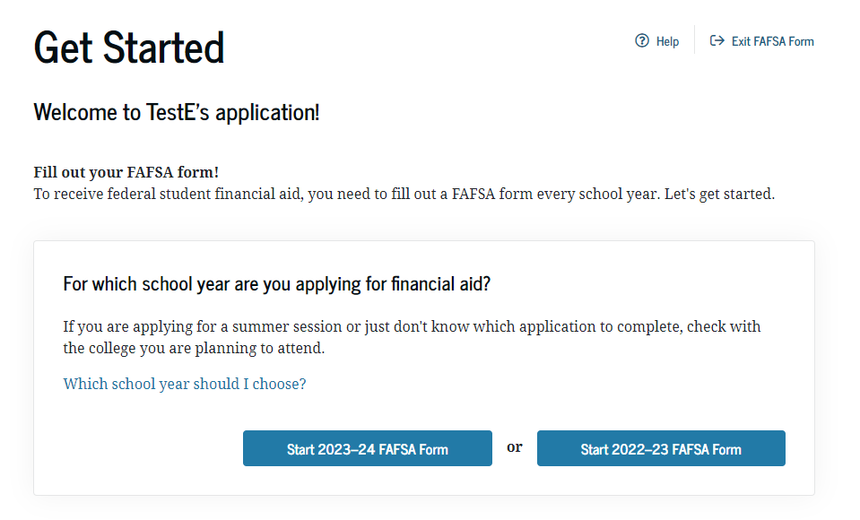
Get Started

Slide 15
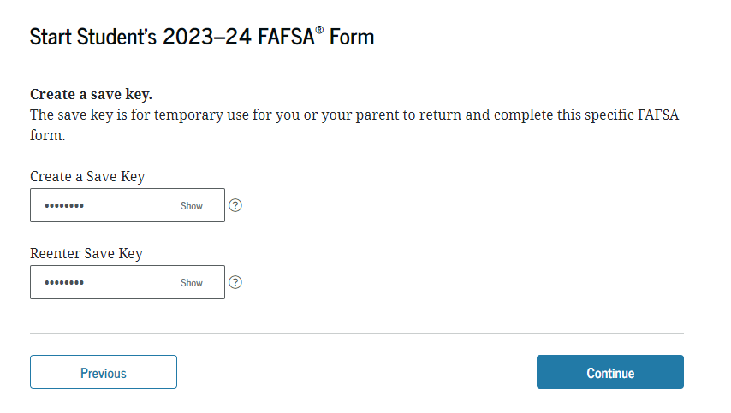
Create Save Key
Write this down!
This will allow you to save the FAFSA and come back to it later if you cannot finish in one sitting.

Slide 16
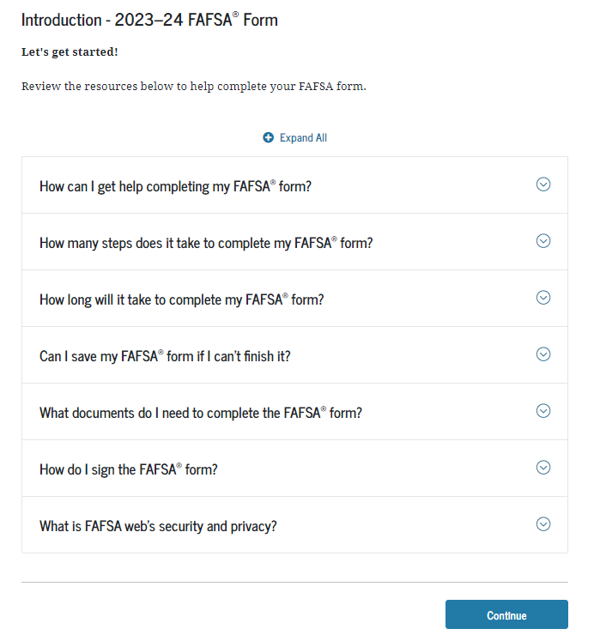
Introduction

Slide 17
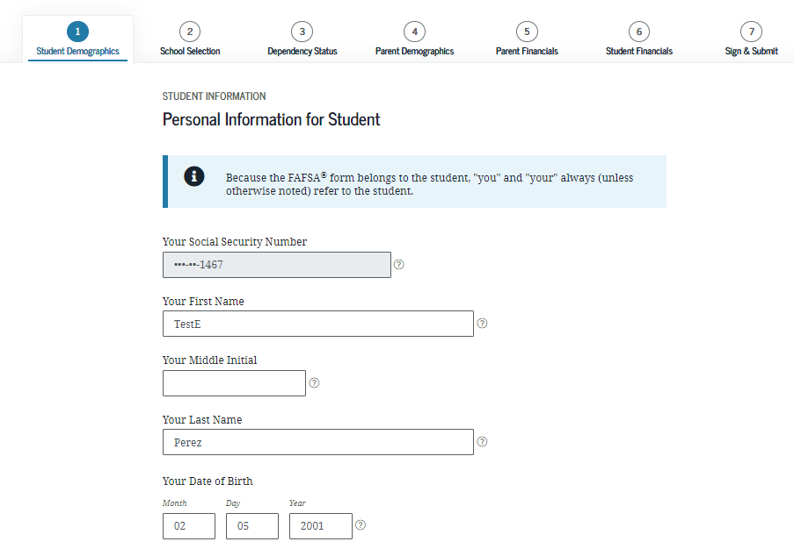
Personal Information for Student
The navigation bar tells you where you are in the application
Click the ‘?’ for help with the questions

Slide 18
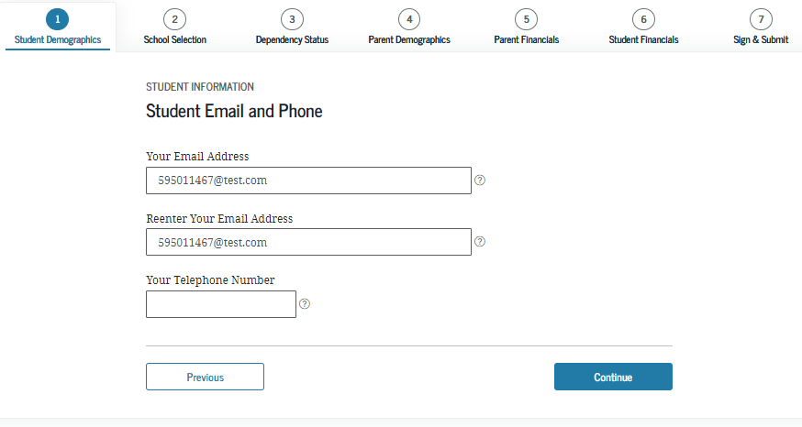
Student Email and Phone
Tip: Don’t use your high school email address.

Slide 19
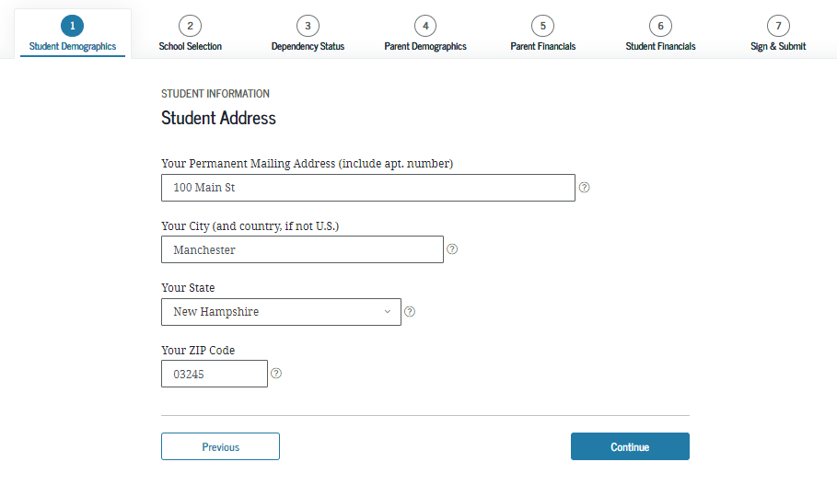
Student Address

Slide 20
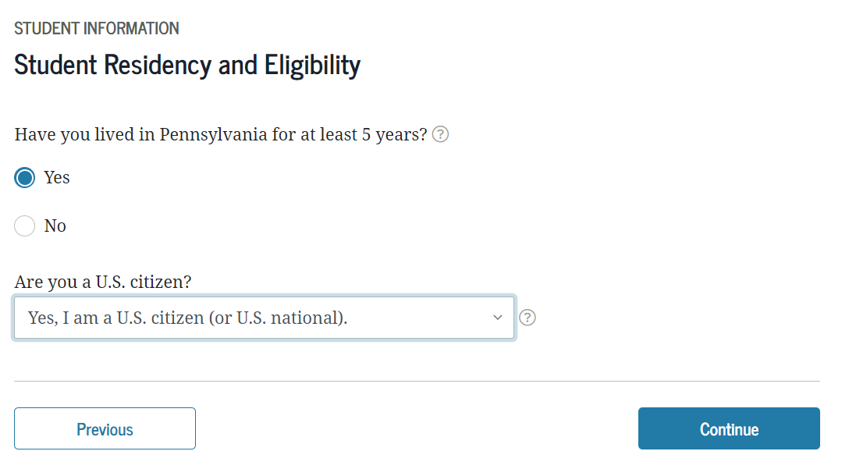
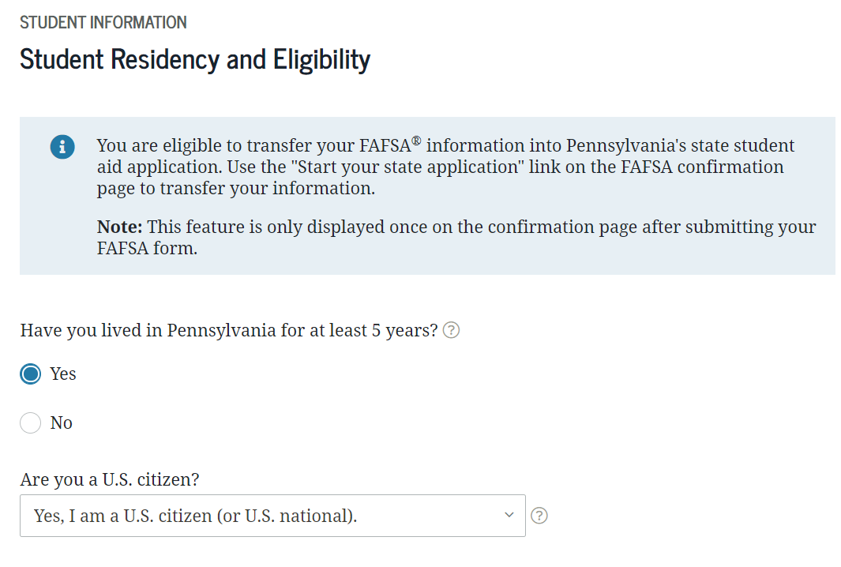
Student Residency and Eligibility

Slide 21
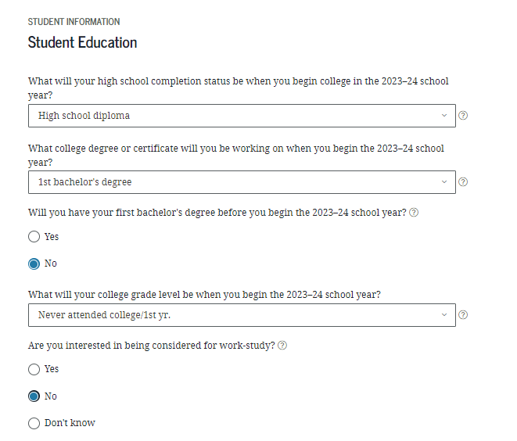

Student Education
Student Demographics

Slide 22
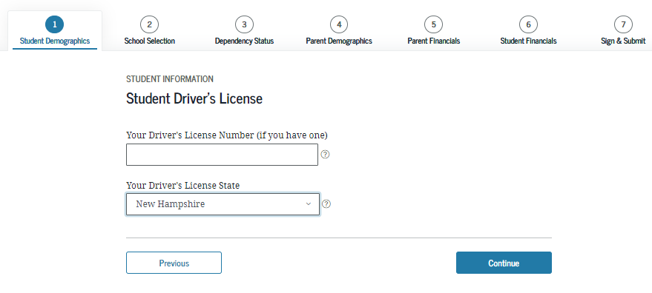
Student Driver’s License
*This is optional

Slide 23
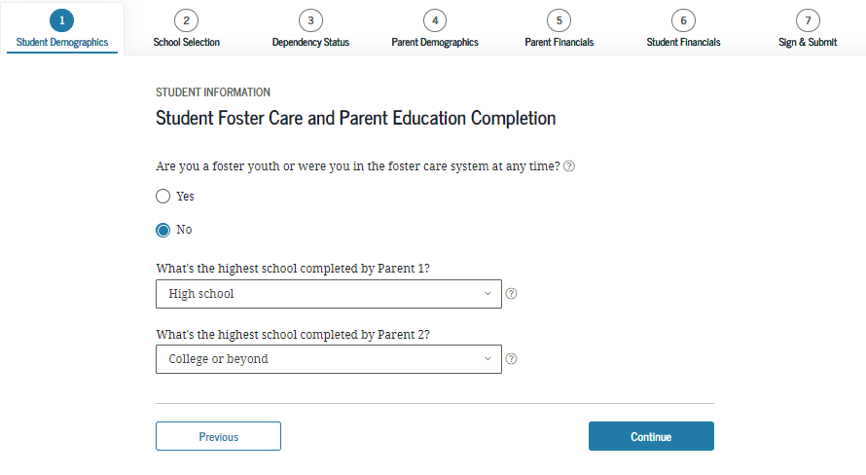
Foster Care and Education Completed
Select the answer that best describes your parent’s (birth or adoptive) highest level of education completed

Slide 24
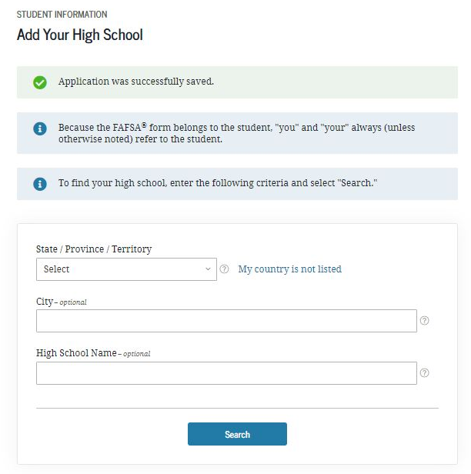
Search for High School
School Selection
Click ‘Search’ and select your High School from the list that appears

Slide 25
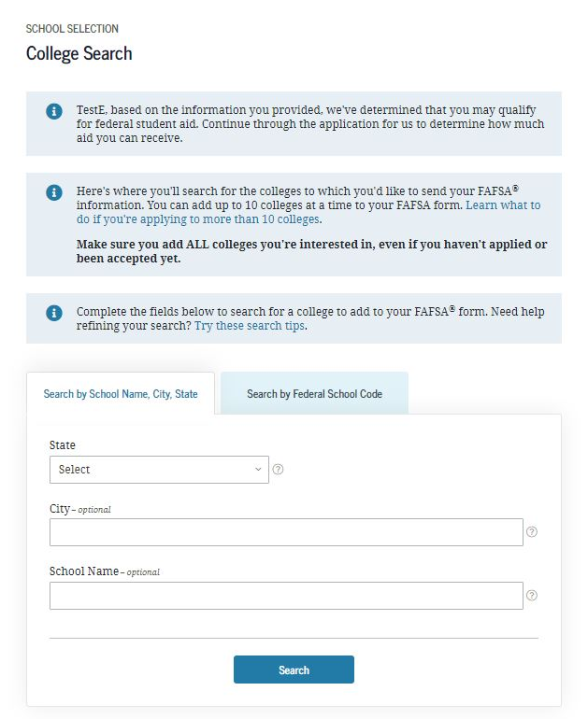
Search for Colleges
School Selection
List more than one!
Only schools that are listed will be able to see your FAFSA information
Students can list up to 10 colleges at a time – Schools can be added or deleted at any time
Once the final school choice is made, students should update their PA State Grant record

Slide 26
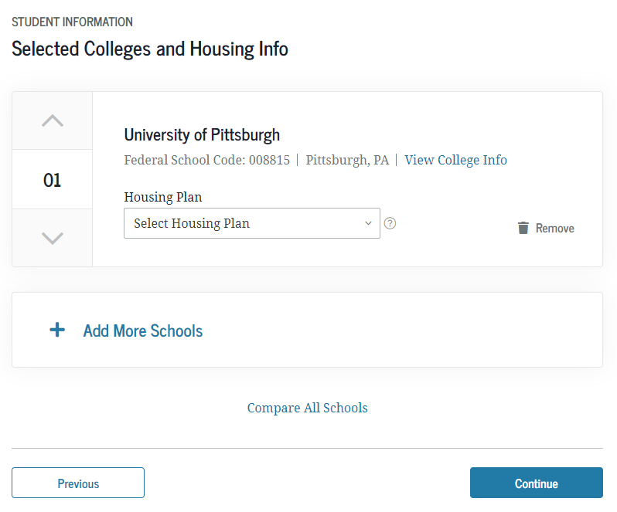
Selected Colleges and Housing Plans
School Selection
Housing choices:
  on campus
  off campus
  with parent

Slide 27
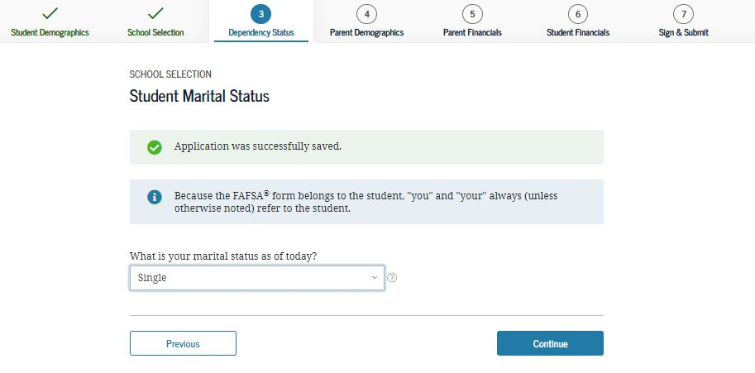
Student Marital Status

Slide 28
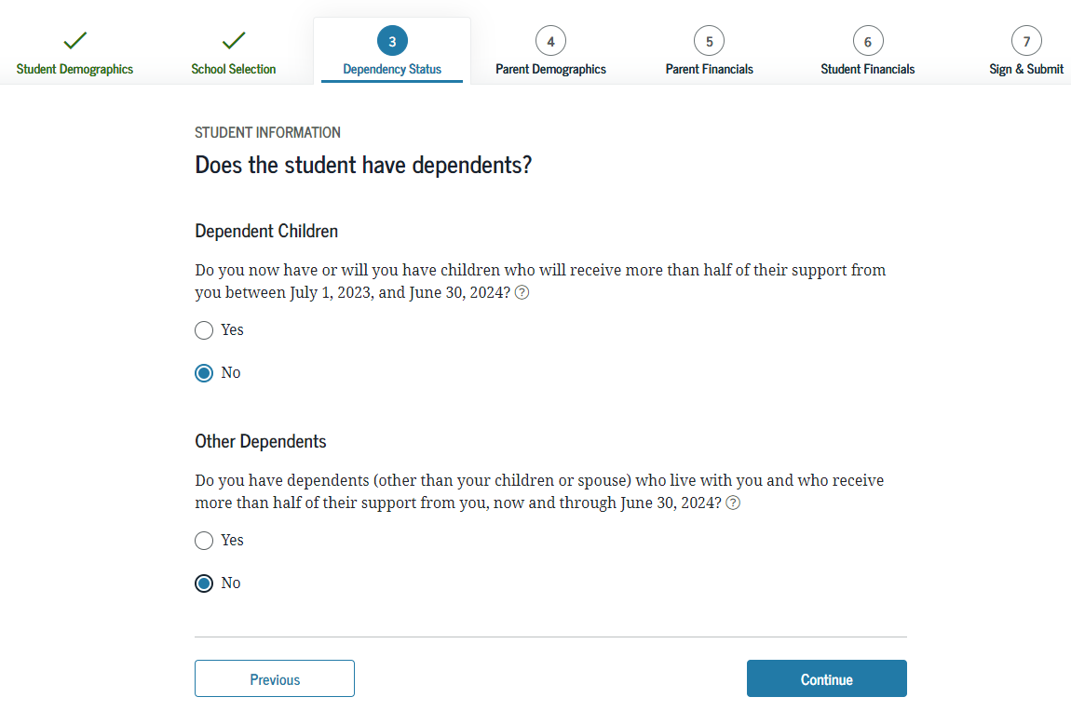
Does the Student Have Dependents?

Slide 29
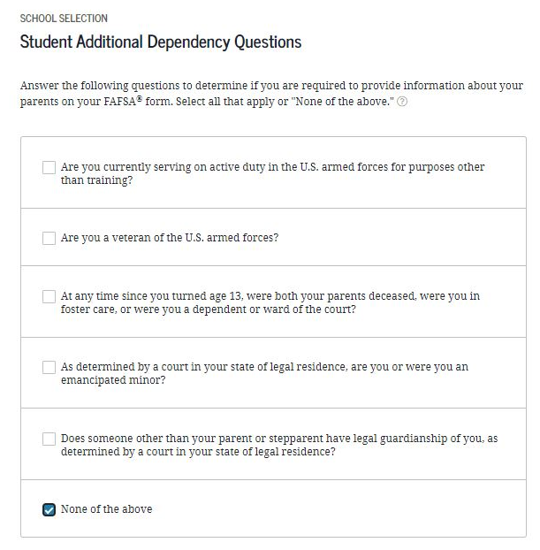
Student Additional Dependency Questions
Dependency Status

Slide 30
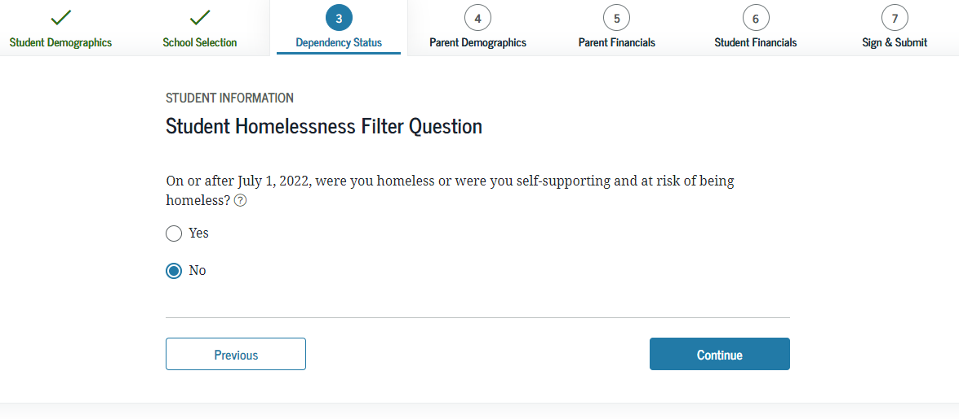
Student Homelessness Question

Slide 31
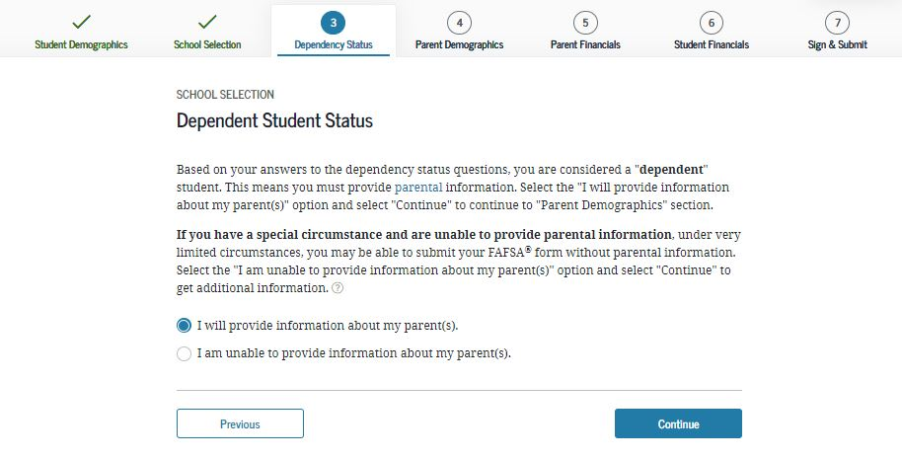
Dependent Student Status

Slide 32
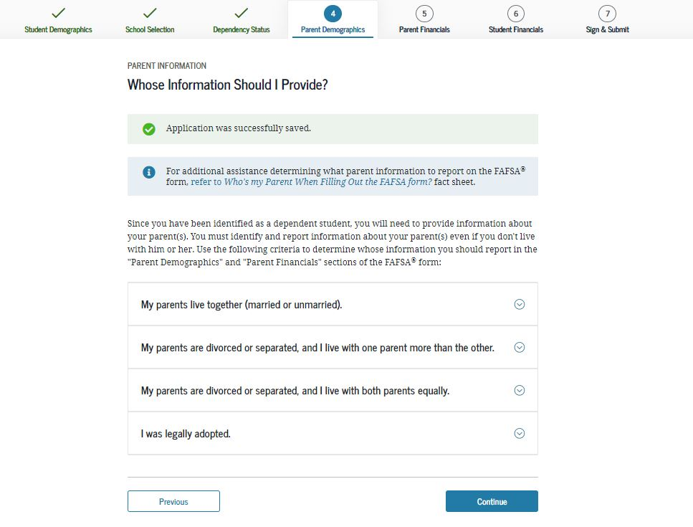
Whose Information Should I Provide?

Slide 33
For Dependent Students, Who Reports Info on the 2023-24 FAFSA?
YES
Married parents living together
Biological parents living together
Divorced or separated parents:
  The parent the student lived with the most over the past 12 months
  If equal, then the parent who provided more than 50% of student’s support
Stepparent – If part of the student’s household
Adoptive parents
NO
Foster Parents
Legal Guardians
  By court order
Anyone else the student is living with

Slide 34
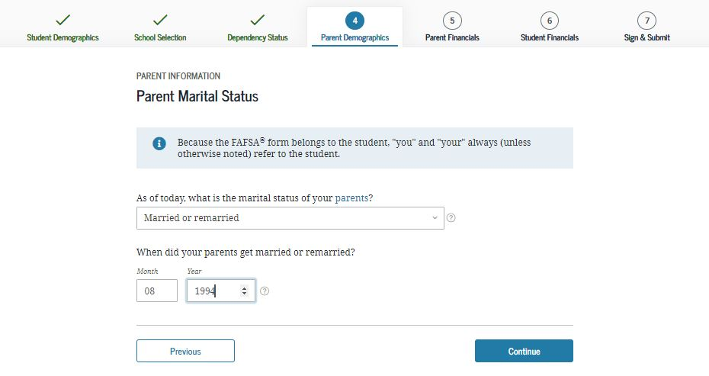
Parent Marital Status

Slide 35
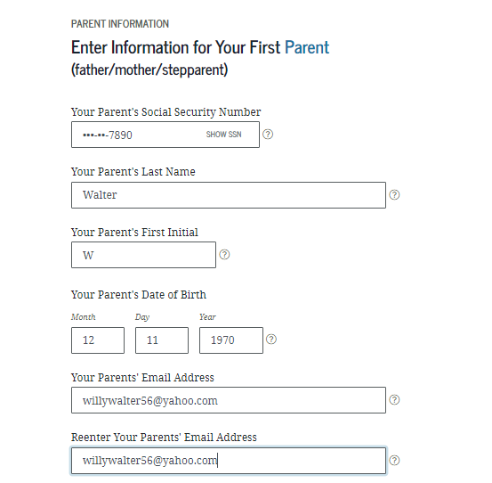
Personal Information for First Parent
Parent Demographics
Remember which parent you list first

Slide 36
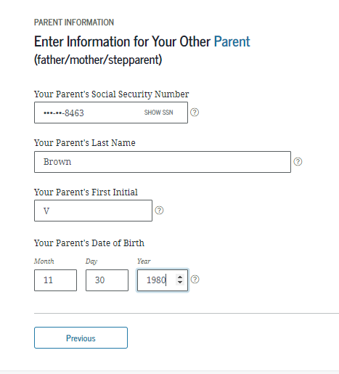
Parent Information for Other Parent
Parent Demographics

Slide 37
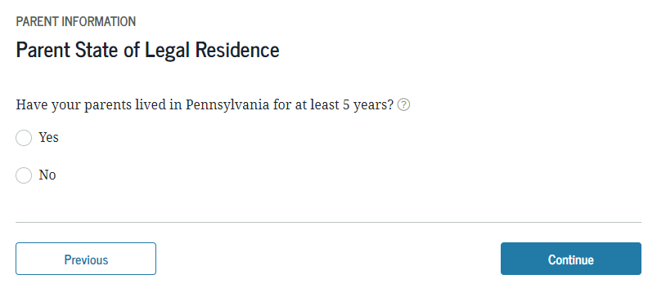
Parent State of Legal Residence
Parent Demographics

Slide 38
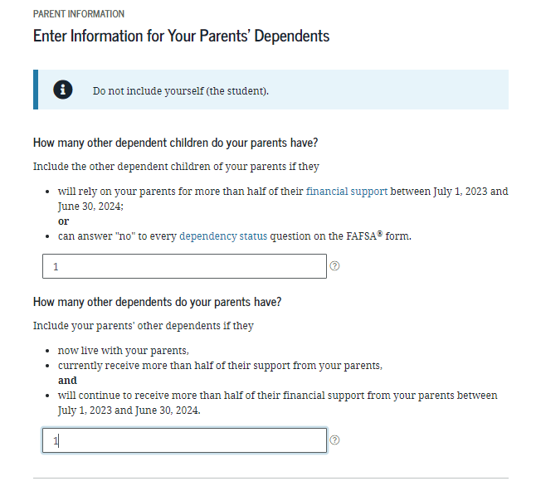
Parents’ Dependents
Parent Demographics

Slide 39
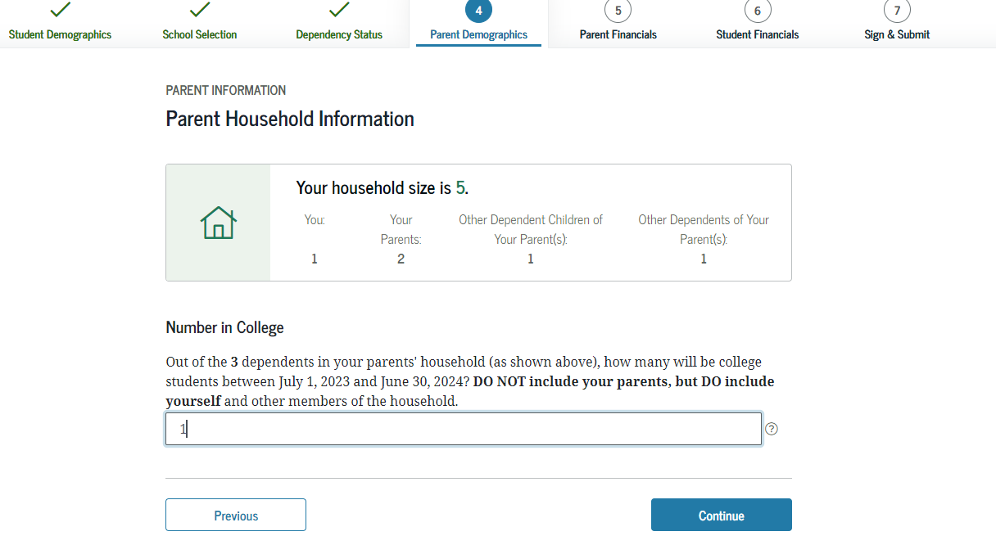
Parent Household Information

Slide 40
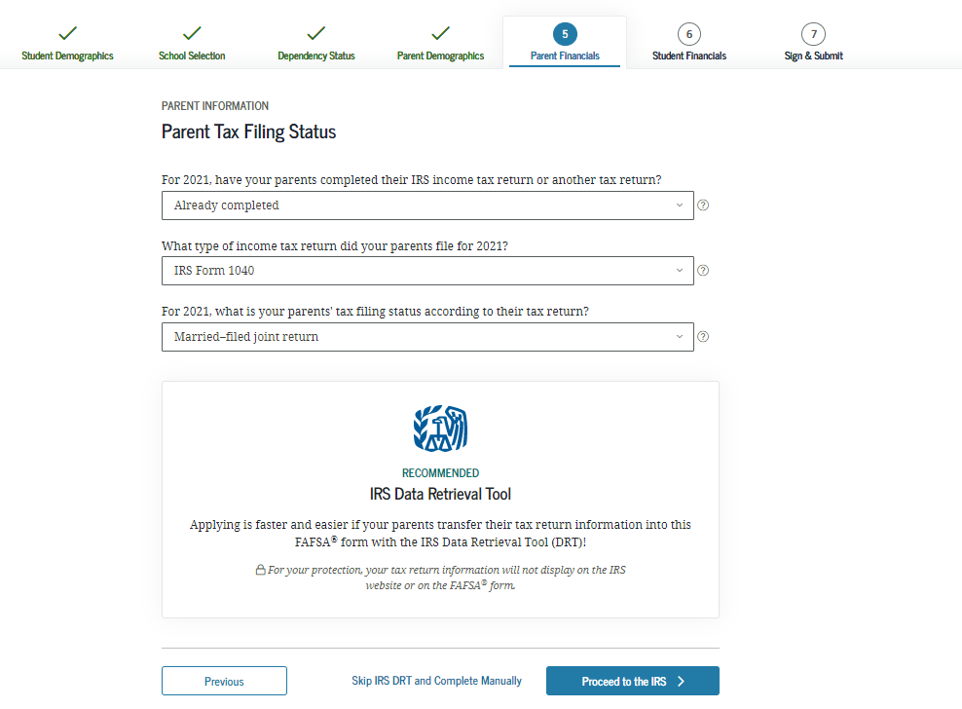
Parent Tax Filing Status

Slide 41
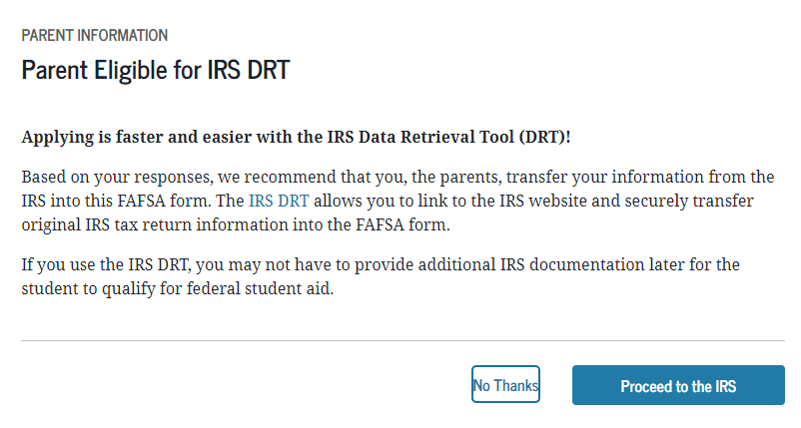
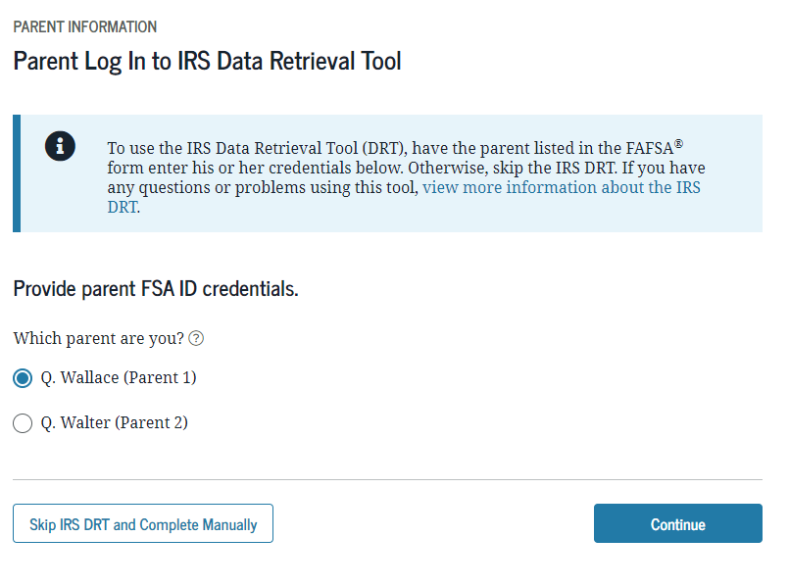
IRS Data Retrieval Tool
Parent Financials

Slide 42
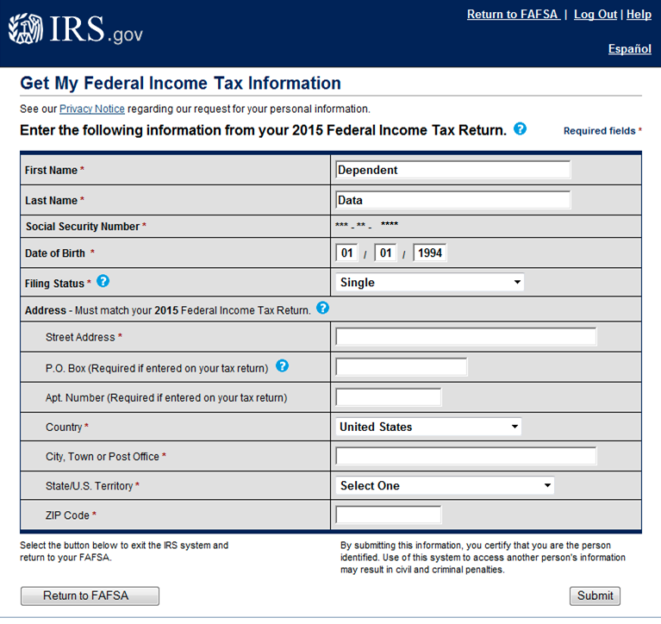
Enter the following information from your 2021 Federal Income Tax Return.
Address – Must match your 2021 federal income tax return

Slide 43
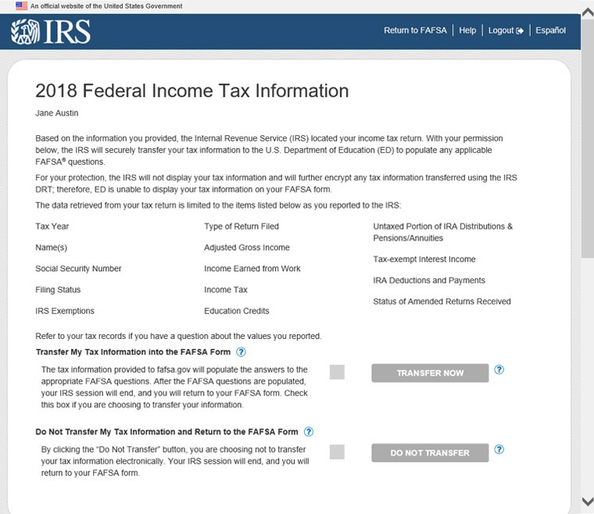
2021 Federal Income Tax Information

Slide 44
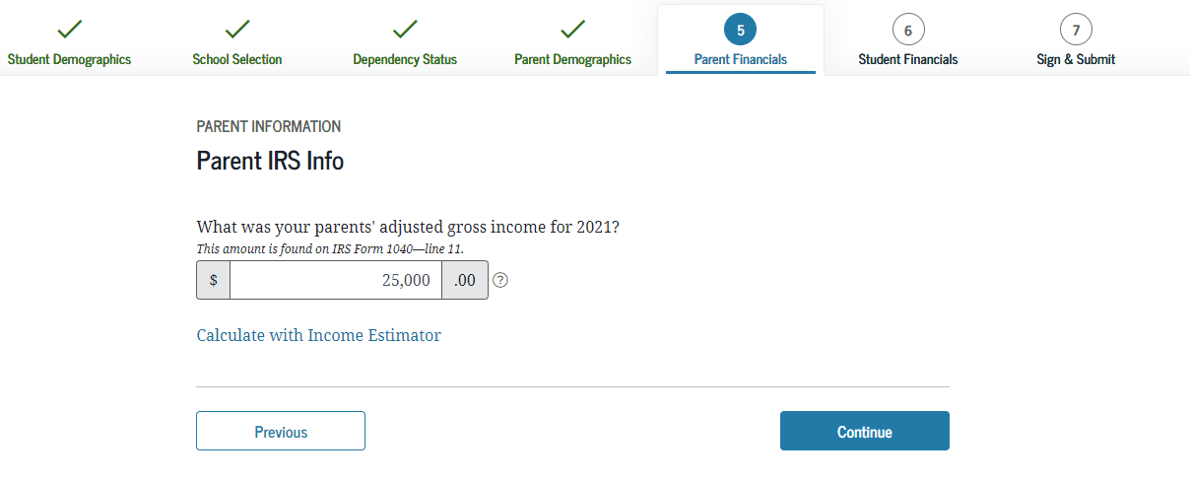
Parent IRS Info
*If you don’t use IRS DRT, you will need to answer this question
*If you use the DRT the amount will show as “Transferred from the IRS”

Slide 45
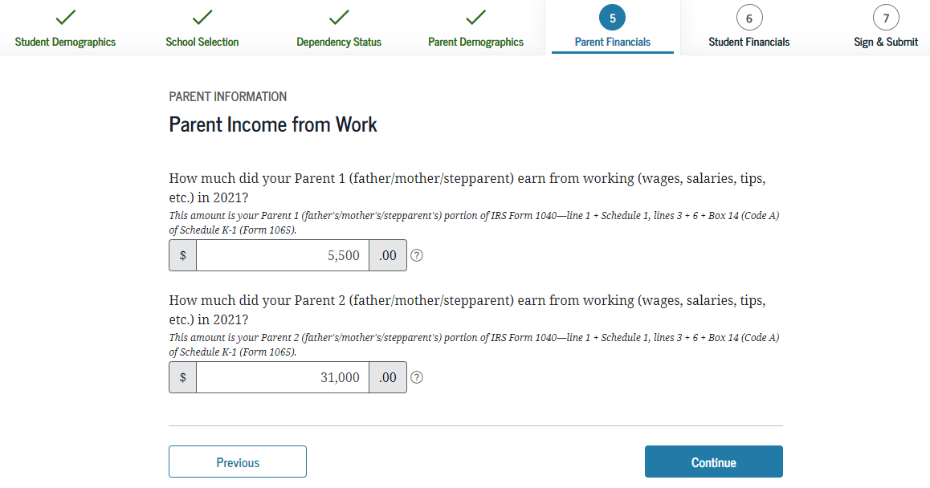
Parent Income from Work

Slide 46
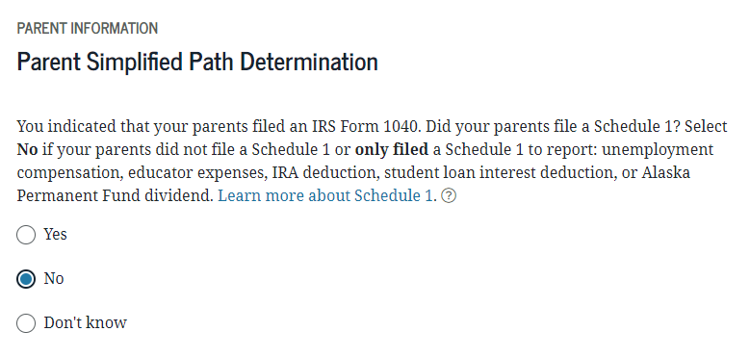
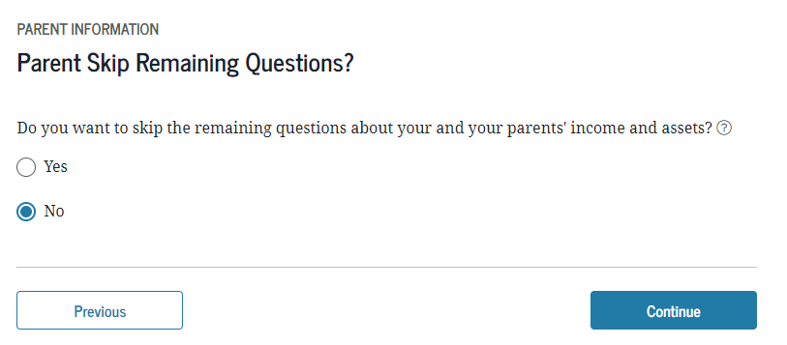
Parent Simplified Path Determination
Parent Financials

Slide 47
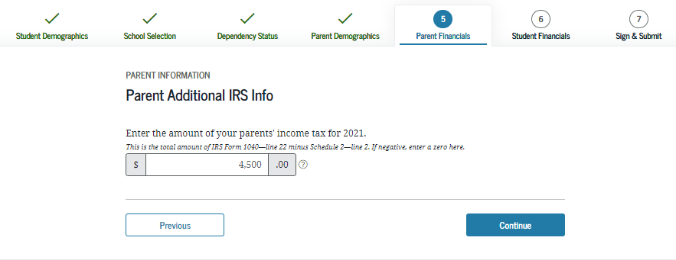
Parent Additional IRS Info

Slide 48
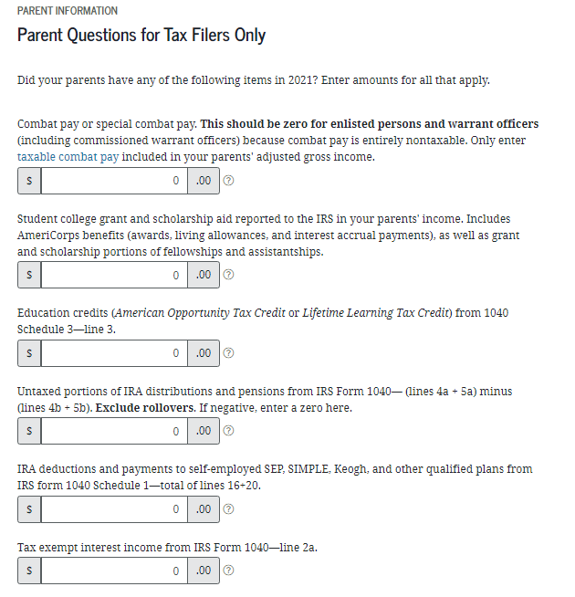
Parent Questions for Tax Filers
Parent Financials

Slide 49
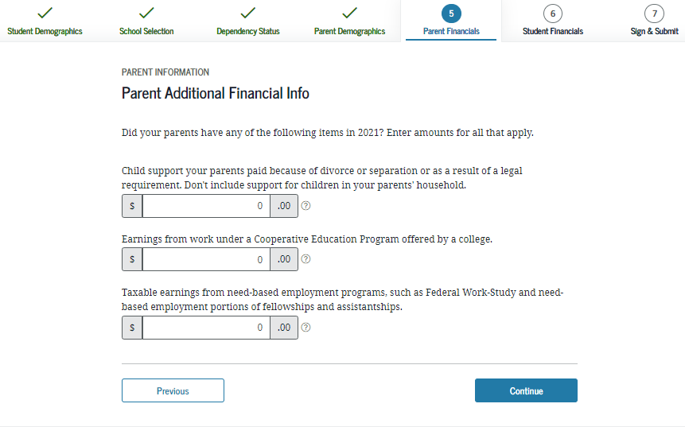
Parent Additional Financial Info

Slide 50
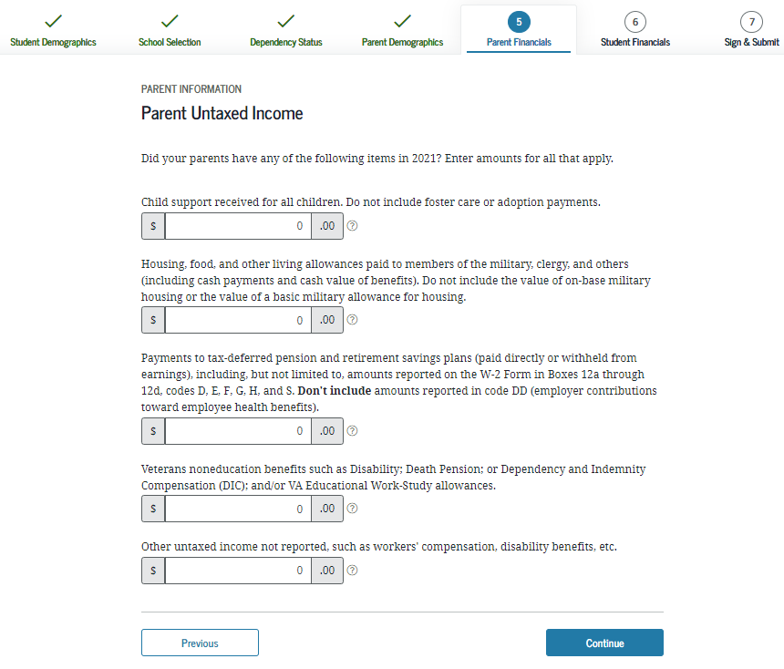
Parent Untaxed Income
Parent Financials
Don’t include untaxed social security benefits or Supplemental Security Income

Slide 51
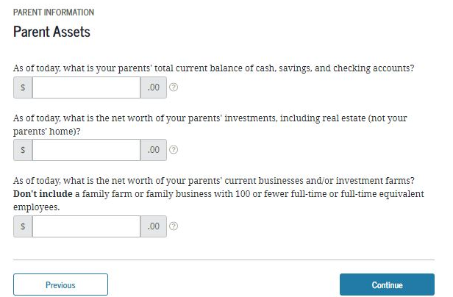
Parent Assets
Parent Financials

Slide 52
What is considered an asset?
  Report the current value at time of filing the FAFSA:
  Cash
  Checking
  Savings
  Investments
  Stocks
  Bonds
  Certificates of deposit (CD)
  Bitcoin
  Mutual funds
  529 Plans – for all children
  Net value of real estate
Farm Value – unless primary place of residence
Business Value – Unless family owned and employs 100 employees or less
  Not reported on FAFSA as an asset:
  Value of primary home
  Value of qualified retirement accounts
  Value of life insurance policies
  Value of personal property

Slide 53
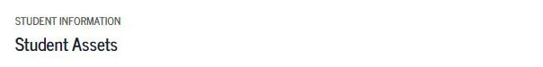
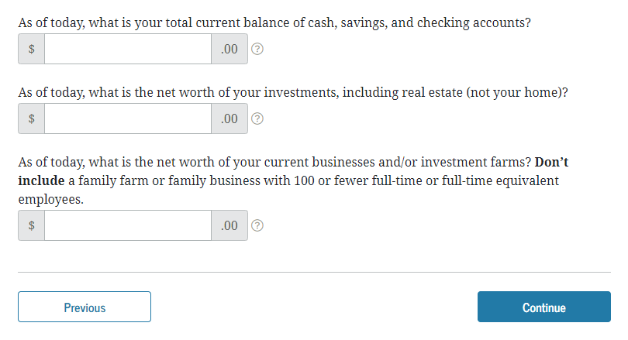
Student Assets
Student Financials
Student is presented with same income questions as the parent financials section
If the student filed a tax return, use the IRS DRT to transfer income into the FAFSA

Slide 54
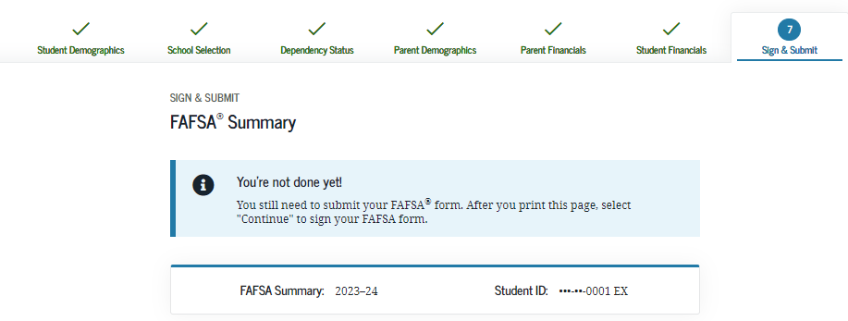
FAFSA Summary

Slide 55


Demographic Survey
Notes:
Demographic Survey view
The demographic survey is new for the 2023 –24 FAFSA® cycle and is only presented once per transaction. Before the user can sign and submit their FAFSA® form, they must respond to the survey.

Slide 56


Agreement of Terms

Slide 57


Student and Parent Signature

Slide 58

Confirmation Page &
Link to the PA State Grant Form

Slide 59


PA State Grant Form

Slide 60


PHEAA Account Access
Create an account to:
  Check your PA State Grant eligibility
  Update your school of choice listed on the PA State Grant Form
  Complete State Grant Form, if you missed the link at the end of the FAFSA

Slide 61
Special Circumstances
If things change….
Divorced or
separated parents
Stepparents
Adoptive parents
Foster parents
Legal guardians
Living with others
Recent death or disability
Reduced income

Slide 62
What Can You Do Now?
Visit College Websites
Create FSA ID & Complete the FAFSA
Utilize Net Price Calculators
collegecost.ed.gov
Explore Scholarships
Talk About What is Affordable

Slide 63

Important Resources
PHEAA.org
StudentAid.gov
CollegeCost.ed.gov
EducationPlanner.org
MySmartBorrowing.org
Scholarship Sites
Collegeboard.org
Fastweb.com
Finaid.org
Scholarshipamerica.org

Slide 64

PHEAA.org/ResourcesStudents

Slide 65
Social Media Outreach
^{PHEAA}
^{American Education Services}
^{@PHEAAaid}
^{@aesSuccessorg}
^{PHEAA}

Slide 66
Questions?
Amy Sloan
Higher Education Access Partner
724-977-3662
Amy.Sloan@pheaa.org

